Slide 1


Noida Institute of Engineering and Technology, Greater Noida
Software Design
Unit: III
Software Engineering
ACSE0603
Dr. Poornima Tyagi
Associate Professor
Department of CSE
( B Tech 6th Sem)

Slide 2
Content
Course Objective
Course Outcomes
CO-PO Mapping
CO-PSO Mapping
Syllabus
Prerequisite
Basic Concept of Software Design,
Architectural Design
Low Level Design
Coupling and Cohesion

Slide 3
Content
Design Strategies
Software Measurement and Metrics
Cyclomatic Complexity Measures
Video Links
Daily Quiz
Weekly Assignment
MCQ
Old Question Papers
Expected Questions for University Exam
Summary
References

Slide 4
Course Objective(unit-3)
An understanding of implementation issues such as modularity and coding standards.
Design, implement, and evaluate software-based systems, components, or programs of varying complexity that meet desired needs, satisfy realistic constraints, and demonstrate accepted design and development principles.

Slide 5
Syllabus
Unit | TOPIC
I | Introduction: Introduction to Software Engineering, Software Components, Software Characteristics, Software Crisis, Software Engineering Processes, Similarity and Differences from Conventional Engineering Processes, Software Quality Attributes. Software Development Life Cycle (SDLC) Models: Water Fall Model, Prototype Model, Spiral Model, Evolutionary Development Models, Iterative Enhancement Models.
II | Software Requirement Specifications (SRS): Requirement Engineering Process: Elicitation, Analysis, Documentation, Review and Management of User Needs, Feasibility Study, Information Modelling, Data Flow Diagrams, Entity Relationship Diagrams, Decision Tables, SRS Document, IEEE Standards for SRS. Software Quality Assurance (SQA): Verification and Validation, SQA Plans, Software Quality Frameworks, ISO 9000 Models, SEI-CMM Model.
III | Software Design: Design principles, the design process; Design concepts: refinement, modularity: Cohesion, Coupling, Effective modular design: Functional independence, Design Heuristics for effective modularity, Software architecture: Function Oriented Design, Object Oriented Design: OOPs concepts-Abstraction, object, classification, inheritance, encapsulation, UML Diagrams-Class Diagram, Interaction diagram, Activity Diagram, control hierarchy: Top-Down and Bottom-Up Design, structural partitioning, software procedure.

Slide 6
Syllabus
Unit | TOPIC
IV | Software Testing: Testing Objectives, Unit Testing, Integration Testing, Acceptance Testing, Regression Testing, Testing for Functionality and Testing for Performance, TopDown and BottomUp Testing Strategies: Test Drivers and Test Stubs, Structural Testing (White Box Testing), Functional Testing (Black Box Testing), Test Data Suit Preparation, Alpha and Beta Testing of Products. Static Testing Strategies: Formal Technical Reviews (Peer Reviews), Walk Through, Code Inspection, Compliance with Design and Coding Standards.
V | Software Maintenance and Software Project management: Software as an Evolutionary Entity, Need for Maintenance, Categories of Maintenance: Preventive, Corrective and Perfective Maintenance, Cost of Maintenance, Software Re- Engineering, Reverse Engineering. Software Configuration Management Activities, Change Control Process, Software Version Control, An Overview of CASE Tools. Estimation of Various Parameters such as Cost, Efforts, schedule/Duration, Constructive Cost Models (COCOMO), Resource Allocation Models, Software Risk Analysis and Management.

Slide 7
Objective of Topics
TOPIC | Objective
Software Design | To Understand the basic concept of design
Low Level Design | Study of Low Level Design
Coupling and Cohesion Measures | To Understand and compare the Coupling and Cohesion
Design Strategies | To examine the different design Strategies
Test Data Suit Preparation, Alpha and Beta | Study of Software Measurement and Metrics
Cyclomatic Complexity Measures | To find the Cyclomatic Complexity

Slide 8
Course Outcome
At the end of the Course, the student will be able
Course Outcomes (CO) |  | Bloom’s Knowledge Level (KL)
ACSE0603.1 | Explain various software characteristics and analyze different software Development Models. | K1, K2
ACSE0306.2 | Demonstrate the contents of a SRS and apply basic software quality assurance practices to ensure that design, development meet or exceed applicable standards. | K1, K2
ACSE0306.3 | Compare and contrast various methods for software design | K2, K3
ACSE0306.4 | Formulate testing strategy for software systems, employ techniques such as unit testing, Test driven development and functional testing. | K3
ACSE0306.5 | Manage software development process independently as well as in teams and make use of Various software management tools for development, maintenance and analysis. | K3

Slide 9
CO-PO Mapping
CO-PO Correlation Matrices
Correlation levels are taken 1, 2 and 3 as defined below:
1: Slight (Low) 2: Moderate (Medium) 3: Substantial (High)
Software Engineering (Code: KCS-601) |  |  |  |  |  |  |  |  | Year of Study: 2020-21
CO | PO1 | PO2 | PO3 | PO4 | PO5 | PO6 | PO7 | PO8 | PO9 | PO10 | PO11 | PO12
ACSE0603.1 | 2 | 3 | 3 | 3 | 2 | - | - | - | - | - | 3 | 3
ACSE0603.2 | 3 | 3 | 3 | 3 | 3 | - | - | - | - | - | 2 | 3
ACSE0603.3 | 3 | 2 | 3 | 2 | 2 | - | - | - | - | - | 3 | 3
ACSE0603.4 | 2 | 2 | 2 | 2 | 3 | 3 | - | 3 | 3 | - | 3 | 3
ACSE0603.5 | 2 | 2 | 3 | 2 | 3 | 3 | - | 3 | - | 3 | 3 | 3

Slide 10
CO-PO and PSO Mapping
Program Specific Outcomes and Course Outcomes Mapping
CO | PSO1 | PSO2 | PSO3 | PSO4
CO1 | 3 | 3 | - | 3
CO2 | 3 | 3 | 2 | 3
CO3 | 3 | 3 | - | 3
CO4 | 3 | 3 | - | 3
CO5 | 3 | 3 | - | 3
*3= High *2= Medium *1=Low

Slide 11
Topic mapping with CO
TOPIC | CO
Software Design: Basic Concept of Software Design, Architectural Design, | CO3
Low Level Design: Modularization, Design Structure Charts, Pseudo Codes, Flow Charts, | CO3
Coupling and Cohesion Measures | CO3
Design Strategies: Function Oriented Design, Object Oriented Design, Top-Down and Bottom-Up Design. | CO3
Software Measurement and Metrics: Various Size Oriented Measures: Halestead’s Software Science, Function Point (FP) Based Measures, | CO3
Cyclomatic Complexity Measures: Control Flow Graphs. | CO3

Slide 12
Prerequisite and Recap
Basic Programming Skills
Innovative Thinking.
Enthusiasm to learn Management concepts.

Slide 13
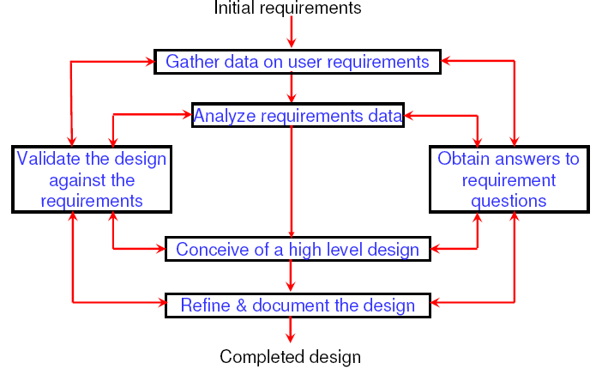
Software Design (CO3)
In this process(phase) designer plans “ How’ a s/w system should be produced as per customer requirements.
SRS tell us “What” a system does. Design Process tell us “How” a s/w system work.
Designing of a s/w system means determining how requirements are realized and result in a s/w design document(SDD).
Framework of design is given below:

Slide 14
Software Design
s/w design process involves the transformation of ideas into details implementation description, with good satisfying the s/w requirement.
First we produce conceptual design that tells customer exactly what the system will do.
Once conceptual design is approved by customer it translate into details design.

Slide 15
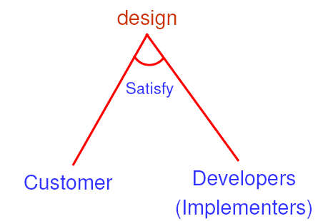
Software Design
It start with initial requirement and ends with final design.
Data is gathered on user requirement and analyze accordingly.
A High level design is prepared after answering question requirements.
Design is validated against requirements on regular basis.
Design is refined in every cycle and finally it is documented to produce SDD(S/w design document)

Slide 16
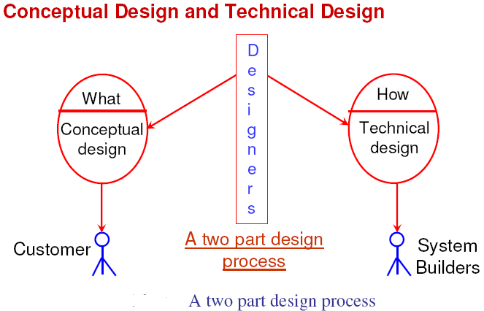
Conceptual design and Technical design (CO3)

Slide 17
Conceptual design and Technical design
To transform req. into working system, designer must satisfy both customer and system(S/W) builder.
A design is a two part iterative process
Conceptual design or preliminary design or high level design: it the identification of different modules and control relationship among them and definition of the interface among these module. It is also called program structure or S/W architecture.
Technical design or detailed design or low level design: it describe h/w configuration, s/w needs, communication interface, I/O of the system, data structure and algorithms of different modules are designed

Slide 18
Conceptual design and Technical design
Conceptual design
Where will the data come from ?
What will happen to data in the system?
How will the system look to users?
What choices will be offered to users?
What is the timings of events?
How will the reports & screens look like?
Technical design
Hardware configuration
Software needs
Communication interfaces
I/O of the system
Software architecture
Network architecture
Any other thing that translates the requirements in to a solution to the customer’s problem.

Slide 19
Outcome of a design process
Out come of a design process:
Different modules required.
Control relationship among modules.
Interfaces among different modules.
Data structure of individual modules.
Algorithm required to implement module.
Characteristic of a good design:
Correctness: implement all functionality identified in SRS doc.
Understandability: interpret by coder and tester.
Efficiency: should be efficient.
Maintainability: easy amenable to change

Slide 20
Design Transformation
Informal design outline
More formal design
Informal design
Finished design
Fig: The transformation of an informal design to a detailed design.

Slide 21
The software design process can be divided into the following three levels or phases of design:
Interface Design
Architectural Design
Detailed Design
Elements of a System
Architecture: This is the conceptual model that defines the structure, behavior, and views of a system. We can use flowcharts to represent and illustrate the architecture.
Modules: These are components that handle one specific task in a system. A combination of the modules makes up the system.
Components: This provides a particular function or group of related functions. They are made up of modules.
Interfaces: This is the shared boundary across which the components of a system exchange information and relate.
Data: This is the management of the information and data flow.

Slide 22
Architectural Design (CO3)
The process of defining a collection of hardware and software components and their interfaces to establish the framework for the development of a computer system.
Outcome of AD/high level design is called program structure or s/w architecture.
Problem is decomposed into a set of modules and manage them with cohesive and low coupling.
Control relationship and interfaces among various modules are identified.
Many notations such as structure chart, UML etc. are used in high level design.

Slide 23
Each style will describe a system category that consists of :
A set of components(eg: a database, computational modules) that will perform a function required by the system.
The set of connectors will help in coordination, communication, and cooperation between the components.
Conditions that how components can be integrated to form the system.
Semantic models that help the designer to understand the overall properties of the system.

Slide 24
Architectural Design
AD methods have various alternative arch. Style of designing a system. these are:
Data flow architecture : flow of data in the system or sub systems.
Object oriented architecture : it involves class and objects
Layered architecture: define no. of layered. Outer layered handle functionality of user interface and inner most layer handle interaction with the H/W.
Data centric architecture: it involves the use of a central database operation such as inserting, updating, etc. in the form of a table.

Slide 25
Data Flow Architecture
Data Flow Architecture focuses on the flow of data within the system or its subsystems. It emphasizes how data moves through different components, processes, and modules of the system.
In this architecture, data is considered as the primary entity, and the emphasis is on understanding how it is processed, transformed, and manipulated as it moves through the system.
Data Flow Diagrams (DFDs) are commonly used to visualize and represent the flow of data in a system. These diagrams typically consist of processes, data stores, data flows, and external entities, illustrating how data moves from one component to another.
Data Flow Architecture is particularly useful for understanding data dependencies, identifying potential bottlenecks, and optimizing data processing workflows within the system.

Slide 26
Object-Oriented Architecture
Object-Oriented Architecture (OOA) is an architectural paradigm that revolves around the concepts of classes and objects. It emphasizes modeling software systems as collections of objects that interact with each other to accomplish tasks.
In OOA, each object represents an instance of a class, which encapsulates data (attributes) and behavior (methods or functions) related to a particular entity or concept in the system.
OOA promotes concepts such as encapsulation, inheritance, polymorphism, and abstraction, which facilitate modular design, code reuse, and maintainability.
Object-Oriented Programming (OOP) languages such as Java, C++, and Python provide constructs and features to implement OOA principles effectively.

Slide 27
Layered Architecture
Layered Architecture is a design pattern that organizes the components of a system into distinct layers, each responsible for a specific aspect of functionality.
Typically, layered architectures consist of multiple horizontal layers stacked on top of each other, with each layer providing services to the layer above it and consuming services from the layer below it.
In a typical layered architecture, the outermost layer often handles user interface functionality, while the innermost layer interacts directly with hardware or external systems. The intermediate layers may include business logic, data access, and infrastructure layers.
Layered architecture promotes separation of concerns, modularity, and maintainability by isolating different aspects of the system's functionality into separate layers, making it easier to understand and modify individual components.

Slide 28
Data-Centric Architecture
Data-Centric Architecture focuses on the centralization and management of data within the system. It revolves around the concept of a central database or data repository that stores and manages all the data used by the system.
In this architecture, data operations such as insertion, retrieval, updating, and deletion are performed primarily on the central database, which serves as the single source of truth for the system.
Data-Centric Architecture often uses a relational database management system (RDBMS) or other data storage technologies to organize and store data in the form of tables, rows, and columns.
This architecture simplifies data management, ensures data consistency, and facilitates data sharing and integration across different components and modules of the system. However, it may introduce challenges related to scalability, performance, and concurrency control in heavily loaded systems.

Slide 29
Low level Design (CO3)
Technical design or detailed design or low level design
Modularization
Coupling
Cohesion
Flow chart
Pseudo codes

Slide 30
Modularization (CO3)
Modularization:
Complex system may be divided into simpler pieces called modules.
A system is composed of modules is called modular.
Module is treated separately If different modules have either no or little interactions with each other.
Cohesion and coupling decide the degree of modularity.
A design solution is considered to be highly modular if different modules in the solution have high cohesion and their inter module coupling are low.

Slide 31
Modularity
Properties of a module
Well defined subsystem
Well defined purpose
Can be separately compiled and stored in a library.
Module can use other modules
Module should be easier to use than to build
Simpler from outside than from the inside.
Modularity is the single attribute of software that allows a program to be intellectually manageable. It enhances design clarity, which in turn eases implementation, debugging, testing, documenting, and maintenance of software product.

Slide 32
Modularity
A system considered modular if it consists of discreet component so that each component can be implemented separately and a change to one component has minimal impact on other component.
No of module grow, the effort associated with integration the module also grows.
So Under modularity and over modularity in a software should be avoided.

Slide 33
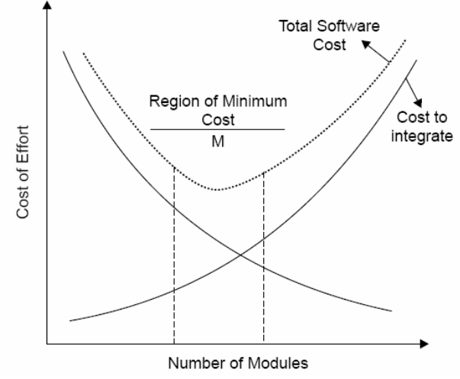
Modularity
Fig. : Modularity and software cost

Slide 34
Module Coupling (CO3)
Coupling is the measure of the degree of interdependence(or no of interconnection) between modules.
Two modules with high coupling are strongly interconnected i.e. dependent on each other.
Two modules with low coupling are not dependent on one another.
A good design will have low coupling.
Design with High coupling will have more error.
Loose coupling minimize the interdependence amongst modules.
Low coupling can be achieve by:
eliminating unnecessary relationships
reducing the number of necessary relationships
easing the ‘tightness’ of necessary relationships

Slide 35
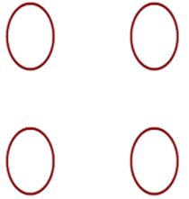
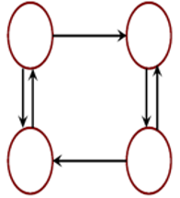
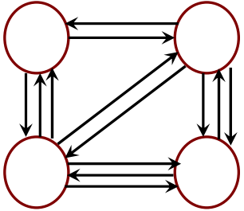
Module Coupling
Uncoupled : no dependencies
Loosely coupled: some dependencies
Highly coupled: many dependencies

Slide 36
Module Coupling
Loose coupling can be achieved as:
Controlling the no of parameter passed amongst modules.
Avoid passing undesired data to calling module.
Maintain parent/child relationship between calling and called modules.
Pass data, not the control information.

Slide 37
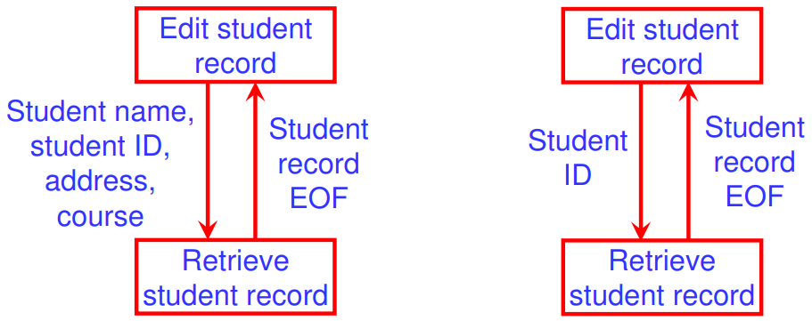
Example of coupling
Consider the example of editing a student record in a ‘student Information system’.
Poor design: Tight Coupling
Good design: Loose Coupling

Slide 38
Types of Module Coupling
Data coupling | Best
Stamp coupling
Control coupling
External coupling
Common coupling
Content coupling | Worst
Strength of coupling from lowest coupling(best) to highest coupling(worst).

Slide 39
Types of Module Coupling
Data coupling
Modules communicate by parameters Each parameter is an elementary piece of data Each parameter is necessary to the communication. Nothing extra is needed
Data coupling problems
Too many parameters - makes the interface difficult to understand and possible error to occur Tramp data - data ‘traveling’ across modules before being used
Stamp coupling
Occurs when A composite data(data structure) is passed between modules problem in stamp coupling
Internal structure contains data not used Bundling - grouping of unrelated data into an artificial structure

Slide 40
Types of Module Coupling
Control coupling
A module controls the logic of another module through the control information(flag)
Controlling module needs to know how the other module works – not
External Coupling
Occurs when another module is external to the s/w being developed or to a particular type of hardware.
It is based on communication to external tools and devices.

Slide 41
Types of Module Coupling
Common coupling
Use of global data as communication between modules
Making a change to the common data means tracing back to all the modules which access that data to evaluate the effect of changes.
problem in Common coupling
ripple effect inflexibility difficult to understand the use of data
It can difficult to determine which value is responsible for having set a variable to a particular values

Slide 42
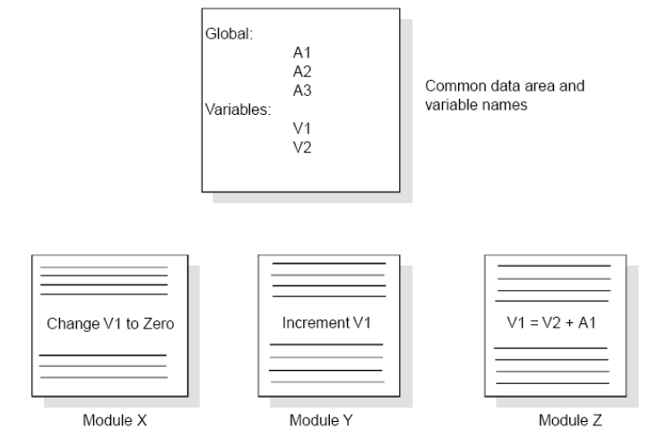
Example of common coupling

Slide 43
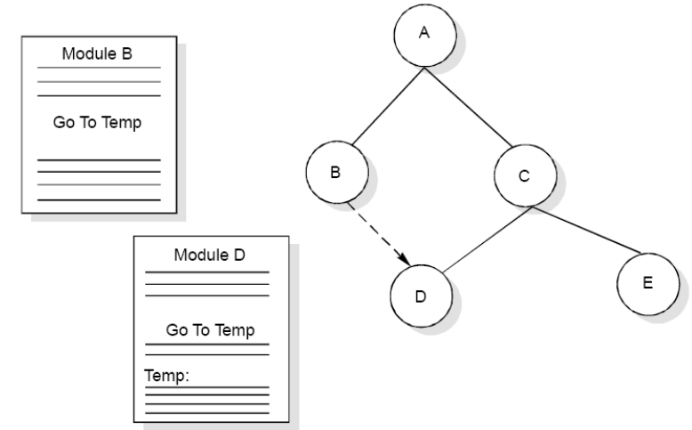
Types of Module Coupling
Content coupling
Content coupling occurs when module A changes data of module B or when control is passed from one module to the middle of another. In Fig. , module B branches into D, even though D is supposed to be under the control of C. A module refers to the inside of another module. Branch into another module Refers to data within another module Changes the internal workings of another module Mostly by low-level languages

Slide 44
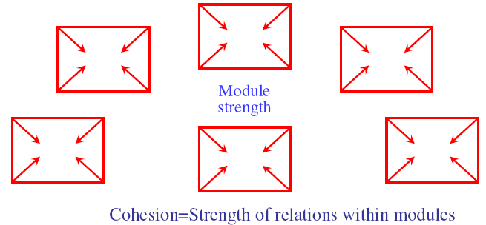
Module Cohesion (CO3)
Cohesion is a measure of the degree(strength) to which the elements of a module are functionally related.

Slide 45
Cohesion
Cohesion
Definition
The degree to which all elements of a module are directed towards a single task.
The degree to which all elements directed towards a task are contained in a single component.
The degree to which all responsibilities of a single class are related.
Internal glue with which Module is constructed
All elements of module are directed toward and essential for performing the same task.
Elements: instructions, groups of instructions, data definition, call of another module.
Strong cohesion will reduce relations between modules - minimize coupling

Slide 46
Type of Cohesion
Functional cohesion
Sequential cohesion
Procedural cohesion
Temporal cohesion
Logical cohesion
Coincident cohesion

Slide 47
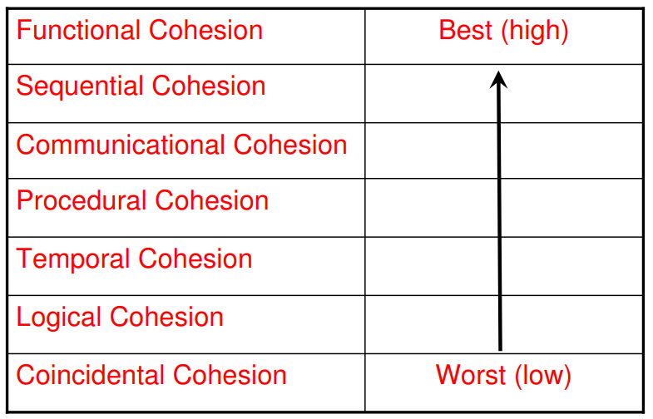
Type of Module Cohesion

Slide 48
Type of Cohesion
High Cohesion
Functional
Sequential
Communicational
Procedural
Temporal
Logical
Coincidental
Low

Slide 49
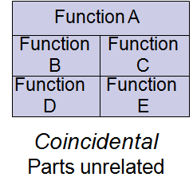
Coincidental Cohesion
Coincident Cohesion: Coincidental cohesion happens when functions within a module are grouped together simply because they operate on the same data, without a clear logical or functional relationship.
Example: In a module for managing student personal information, functions might include update_student_name, update_student_address, and update_student_contact. These functions are grouped together because they all operate on the student's personal information, but there may not be a strong logical relationship between them.

Slide 50
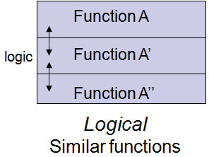
Logical Cohesion
Logical Cohesion: Logical cohesion occurs when functions within a module are grouped together because they contribute to a well-defined logical task, often involving decisions or choices.
Example: In a module for handling student course registration, functions might include check_course_prerequisites, enroll_student_in_course, and validate_registration. These functions are grouped based on the logical steps involved in the registration process.
Several logically related elements are in the same module and one of the elements is selected by the client module. Ex.
A module reads inputs from tape, disk, and network.
All the code for these functions are in the same module.
Operations are related, but the functions are significantly different.

Slide 51
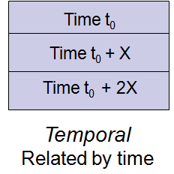
Temporal Cohesion
Temporal Cohesion: Temporal cohesion would be evident if functions within a module are grouped together because they are all executed at the same time or during a specific period.
Example: In a module for generating student timetables, functions might include create_timetable, assign_rooms, and publish_timetable. These functions are executed concurrently at the beginning of each academic term.
Example: An exception handler that
Closes all open files
Creates an error log
Notifies user
Lots of different activities occur, all at same time
51

Slide 52
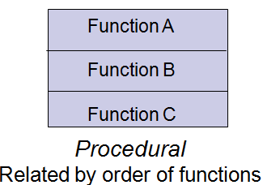
Procedural Cohesion
Procedural Cohesion: Procedural cohesion occurs when functions within a module are grouped together because they contribute to a specific procedural task, but there's no inherent logical relationship between them.
Example: In a module for managing student attendance, functions might include mark_attendance, calculate_absenteeism_rate, and notify_parents_of_absence.

Slide 53
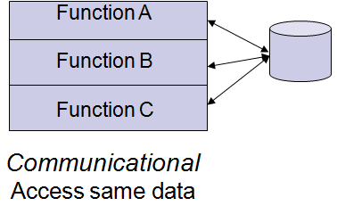
Communicational Cohesion
Functions performed on the same data or to produce the same data.
Examples:
Update record in data base and send it to the printer
Update a record on a database
Print the record
53

Slide 54
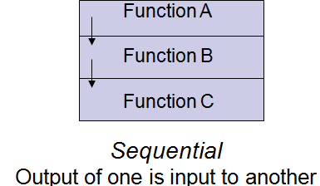
Sequential Cohesion
Sequential Cohesion: Sequential cohesion would be present if the functions within a module are arranged in a sequence where the output of one function serves as the input to the next function.
Example: In a module for processing student grades, functions might be arranged sequentially to input grades, calculate averages, and generate reports. Each function relies on the output of the previous function in the sequence.
54

Slide 55
Functional Cohesion
Functional Cohesion: In a student information system, functional cohesion would occur if all functions within a module contribute to a single, well-defined task related to student information management.
Example: In a module responsible for student enrollment, functions might include add_student, remove_student, update_student_info, and generate_student_report. All these functions relate to the single task of managing student enrollment.
55

Slide 56
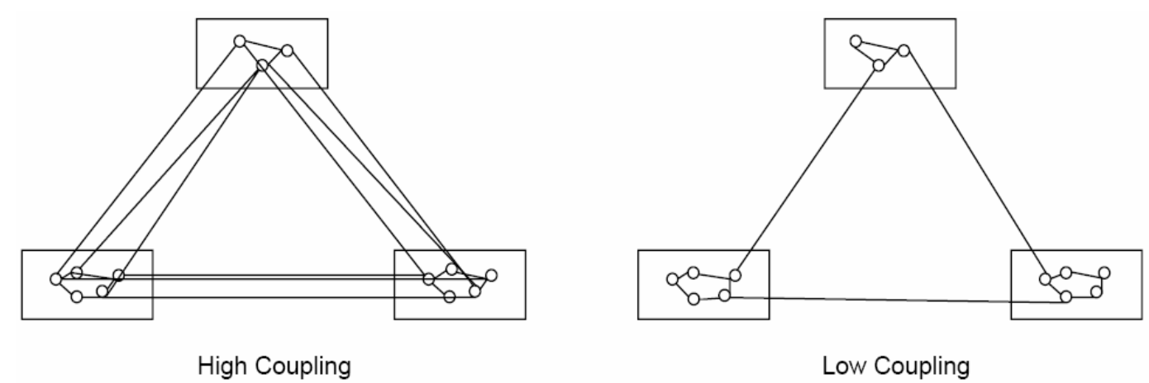
Relationship between cohesion & coupling (CO3)
If the software is not properly modularized, a host of seemingly trivial enhancement or changes will result into death of the project. Therefore, a software engineer must design the modules with goal of high cohesion and low coupling.

Slide 57
Flow Chart (CO3)
It is convenient technique to represent the flow of control in a program.
It is a graphical representation of an algorithms.
It also help during testing and modifications in the programs.
Advantage of Flow chart:
It help in following ways:
Synthesis(Systematic combination of different elements.)
Coding
Debugging
Communication
Testing

Slide 58
Flow Chart
Limitation:
No standard way that should be included in flow chart.
Difficult to draw, if algorithms has complex branches and loops.
Time consuming process for large complex problems
Difficult to include any new step in existing flow chart.

Slide 59
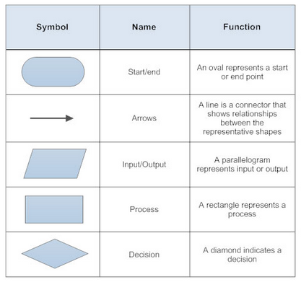
Basic Component of Flow Chart

Slide 60
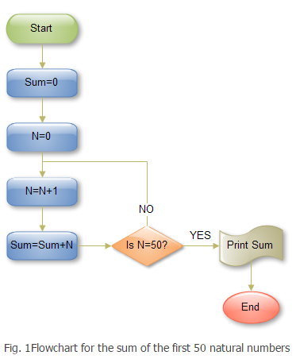
Example 1

Slide 61
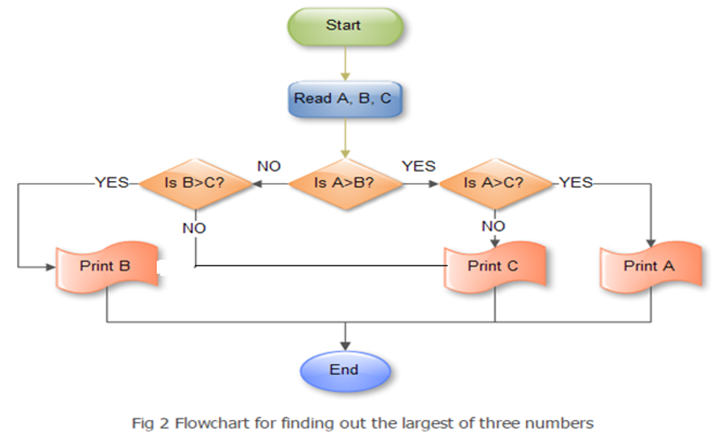
Example 2

Slide 62
Structure Chart (CO3)
A structure chart to breakdown the system to its lowest manageable levels.
They are used in structured programming to arrange program modules in tree structure. It visualizes the relationships between modules.
When a module calls another, it views the called module as black box passing required parameters and receiving results.
Connection between modules are represented by lines between rectangular boxes.
Component are generally read from top to bottom and left to right.
Top level modules called lower level modules.
It has only one module on the top called root.

Slide 63
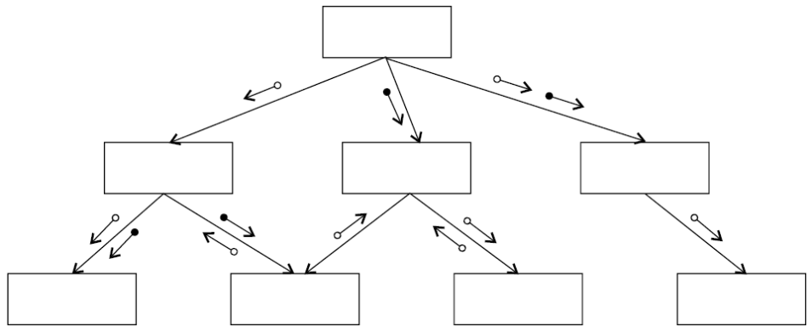
Structure Chart
It partition a system into block boxes. A black box means that
functionality is known to the user without the knowledge of internal design.

Slide 64
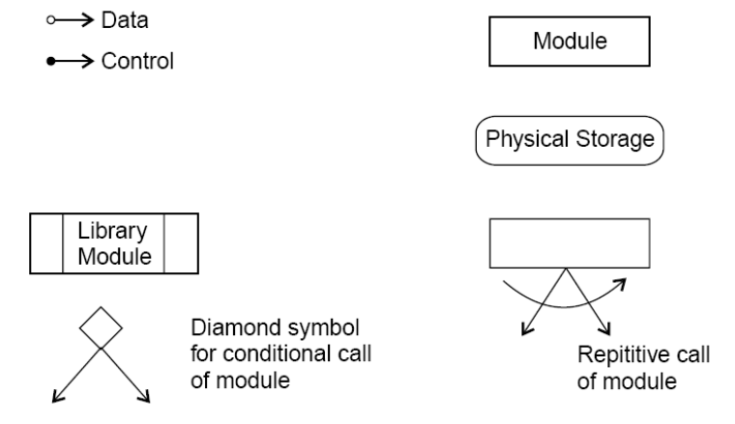
Notation of Structure Chart

Slide 65
Notation of Structure Chart
Rectangular boxes: Represents a module.
Module invocation arrows: Control is passed from one module to another module in the direction of the connecting arrow.
Data flow arrows: Arrows are annotated with data name; named data passes from one module to another module in the direction of the arrow.
Library modules: Represented by a rectangle with double edges.
Selection: Represented by a diamond symbol.
Repetition: Represented by a loop around the control flow arrow.

Slide 66
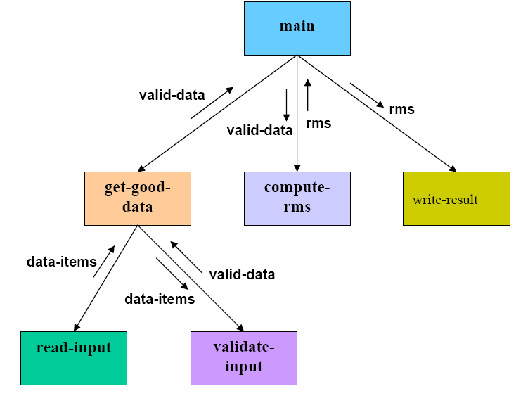
Structure Chart Ex.1: rms calculator

Slide 67
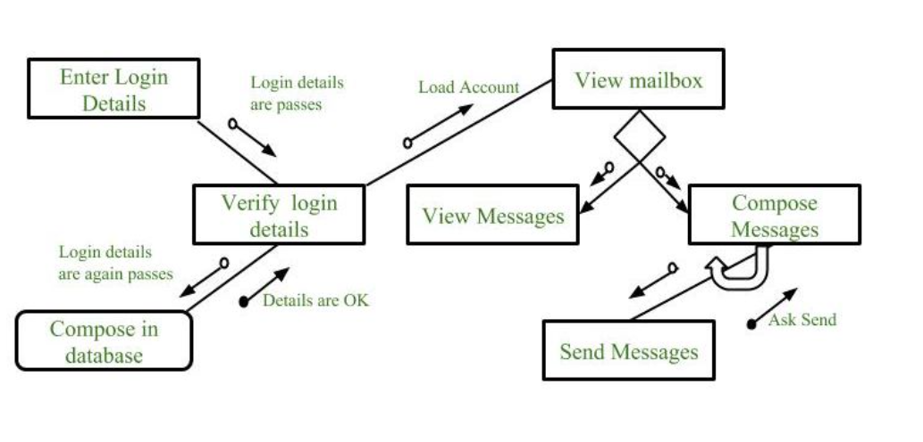
Structure chart of Email Server

Slide 68
Pseudo Code (CO3)
Pseudo code notation can be used in both the preliminary (high level)and detailed design(low level) phases.
Code are effective and building block for actual program.
Using pseudo code, the designer describes system characteristics using short, concise, English language phrases that are structured by key words such as If-Then-Else, While-Do, and End.
Advantage of pseudo code(compare to flow chart)
Easy to convert in programming language.
Easy to modify.
Require less time and effort to write it.
Easy to write than writing a program in programming language.
Disadvantage of pseudo code:
No graphical representation of program logic.
No standard rule are follows to writing pseudo code

Slide 69
Pseudo Code
Problem: find smallest number among three variables
1. read values of a, b and c variables
2. if (a < b)
{
if(a < c)
print “a is small”
else print “c is small”
else if(b < c)
print “b is small”
else print “c is small”
3. end.

Slide 70
STRATEGY OF DESIGN (CO3)
A good system design strategy is to organize the program modules in such a way that are easy to develop and latter to, change. Structured design techniques help developers to deal with the size and complexity of programs. Analysts create instructions for the developers about how code should be written and how pieces of code should fit together to form a program. It is important for two reasons:
First, even pre-existing code, if any, needs to be understood, organized and pieced together.
Second, it is still common for the project team to have to write some code and produce original programs that support the application logic of the system

Slide 71
STRATEGY OF DESIGN
Top down design
Bottom up design.
Function oriented design.
Object oriented design.

Slide 72
Top Down Design (CO3)
Top-down design takes the whole software system as one entity and then decomposes it to achieve more than one sub-system or component based on some characteristics.
Each sub-system or component is then treated as a system and decomposed further. This process keeps on running until the lowest level of system in the top-down hierarchy is achieved.
Top-down design starts with a generalized model of system and keeps on defining the more specific part of it. When all components are composed the whole system comes into existence.
Top-down design is more suitable when the software solution needs to be designed from scratch and specific details are unknown.

Slide 73
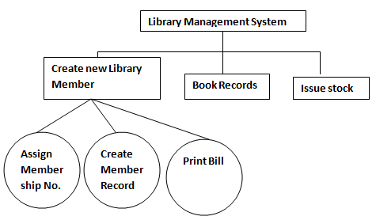
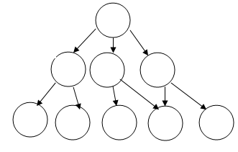
Top Down Design

Slide 74
Advantages
More Systematic
Easy to understand and provide a modular architecture
In correspondence with user requirement cost and time prediction is possible.
Should be used with small and medium size products.
Used mostly
Disadvantages
When a problem is very complex and very large then we can not understand the entire problem as a whole

Slide 75
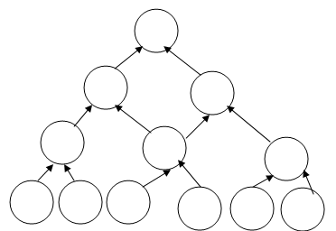
Bottom up Design (CO3)
The bottom up design model starts with most specific and basic components.
This approach is important as the s/w grows in complexity in a systematic fashion. If the problem is very difficult to understand instead of understanding the entire problem, we must solve some sub problem and then should keep repeating the process until the entire problem is solved.

Slide 76
Advantages
Should be used on large size projects.
Easy to use by designers as we work in incremental fashion.
Disadavantage
It has complex architecture very difficult to understand and maintain.

Slide 77
Bottom-up Design
Bottom-up strategy is more suitable when a system needs to be created from some existing system, where the basic primitives can be used in the newer system.
Hybrid Design :Both, top-down and bottom-up approaches are not practical individually. Instead, a good combination of both is used.

Slide 78
Function oriented Design (CO3)
Function Oriented design is an approach to software design where the design is decomposed into a set of interacting units where each unit has a clearly defined function. Thus, system is designed from a functional viewpoint.
Procedure
Start with a high level description of what the software / program does.
Refine each part of the description one by one by specifying in greater details the functionality of each part.
These point led to top- down Structure

Slide 79
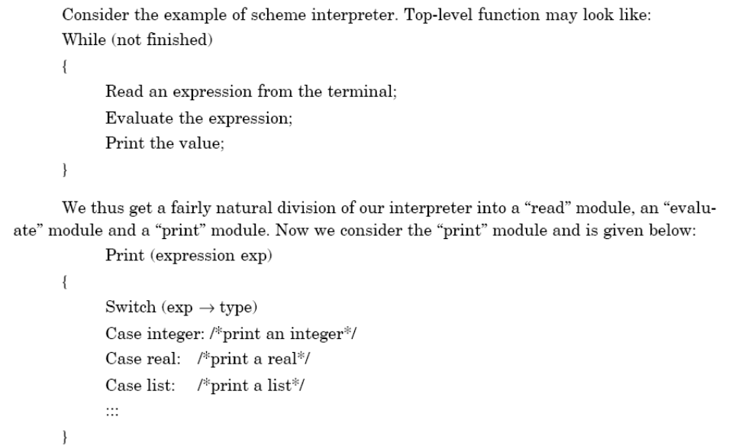
Function Oriented Design

Slide 80
Function oriented Design
In function-oriented design, the system is comprised of many smaller sub-systems known as functions. These functions are capable of performing significant task in the system. The system is considered as top view of all functions.
Function oriented design inherits some properties of structured design where divide and conquer methodology is used.
This design mechanism divides the whole system into smaller functions. These functional modules can share information among themselves by means of information passing and using information available globally.
Another characteristic of functions is that when a program calls a function, the function changes the state of the program, which sometimes is not acceptable by other modules. Function oriented design works well where the system state does not matter and program/functions work on input rather than on a state.

Slide 81
Difference between Top – down and Functional Approach
Aspect | Function-Oriented Approach | Top-Down Approach
Focus | Identifying and defining specific functions or tasks | Defining overall system architecture and structure
Objectives
Modularity | Emphasis on achieving modularity through functional components | Establishing a hierarchical structure for the system
Reusability | Promoting code reusability through modular design | Focusing on system integration and interface definitions
Maintainability | Facilitating easier maintenance through localized changes | Ensuring coherence and consistency in the system design
Functionality-Centric Design | Ensuring effective fulfillment of functional requirements | Providing high-level abstraction of the system's design

Slide 82
Design Process
The whole system is seen as how data flows in the system by means of data flow diagram.
DFD depicts how functions changes data and state of entire system.
The entire system is logically broken down into smaller units known as functions on the basis of their operation in the system.
Each function is then described at large.

Slide 83
FOD notations
For FOD, the design can be represented graphically and mathematically by following:
Data flow diagram.
Data dictionary.
Structure chart.
Pseudo code.

Slide 84
Object Oriented concepts (CO3)
Object oriented design is the result of focusing attention not on the function performed by the program, but instead on the data that are to be manipulated by the program.
Important concepts of Object Oriented Design:
Objects - All entities involved in the solution design are known as objects. For example, person, banks, company and customers are treated as objects. Every entity has some attributes methods to perform on the attributes.
Classes - A class is a generalized description of an object. An object is an instance of a class. Class defines all the attributes, which an object can have and Operations(methods), which defines the functionality of the object.

Slide 85
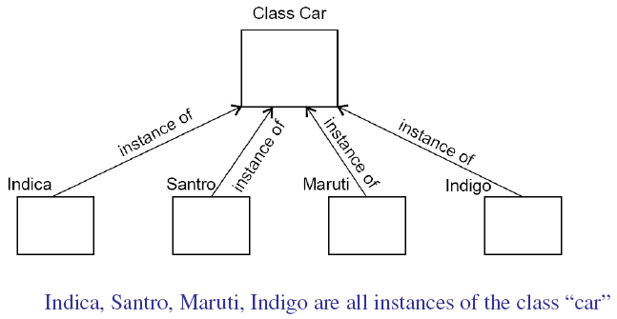
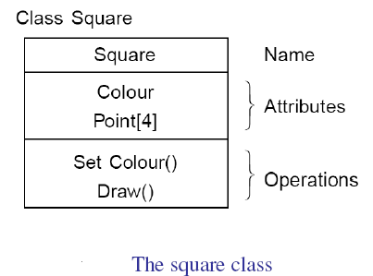
Object Oriented Design

Slide 86
Object Oriented concepts
Attribute
An attributes is a data value held by the objects in a class.
Operation
An operation is a function or transformation that may be applied to or by objects in a class
Inheritance -
OOD allows similar classes to stack up in hierarchical manner where the lower or sub-classes can import, implement and re-use allowed variables and methods from their immediate super classes. This property of OOD is known as inheritance.

Slide 87
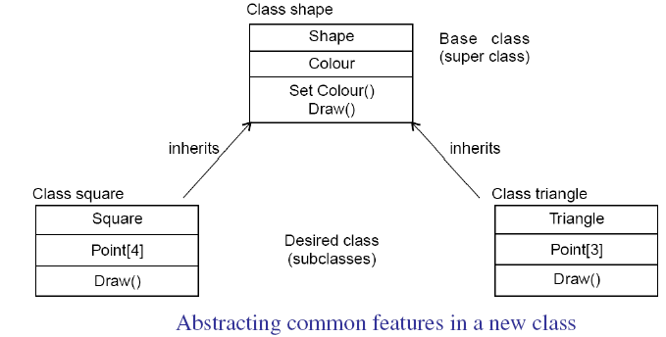
Object Oriented concepts

Slide 88
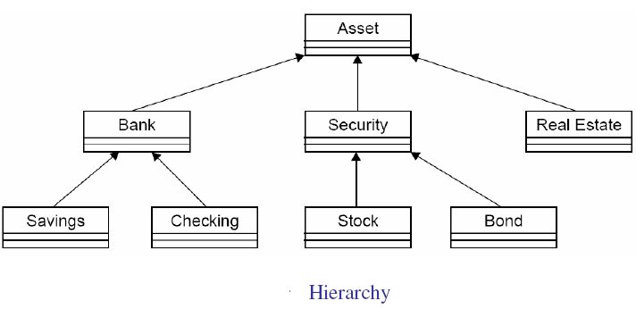
Object Oriented concepts
Encapsulation - In OOD, the attributes (data variables) and methods (operation on the data) are bundled together is called encapsulation. Encapsulation restricts access of the data and methods from the outside world. This is called information hiding.
Polymorphism - OOD languages provide a mechanism where methods performing similar tasks but vary in arguments, can be assigned same name. This is called polymorphism.

Slide 89
Design Process
It may have the following steps involved:
A solution design is created from requirement or previous used system and/or system sequence diagram.
Objects are identified and grouped into classes on behalf of similarity in attribute characteristics.
Class hierarchy and relation among them is defined.
Application framework is defined.

Slide 90
Software Matrices and Measurement (CO3)
It is the estimation of s/w project parameters such as:
Effort
Time duration completing the project
Total cost for developing the s/w project
Project size is a measure of the problem complexity in term of effort and time require to develop the product.
Two matrices are popularly used to estimate size:
Lines of Code(LOC)
Function Point(FP)
Lines of code:
it is any line of program text that is not a comment or blank line, regardless of the number of statements or fragments of statements on the line.
This specifically includes all lines containing program header, declaration, and executable and non-executable statements

Slide 91
Faculty Video Links, Youtube & NPTEL Video Links and Online Courses Details
https://nptel.ac.in/courses/106/105/106105182/
https://www.youtube.com/watch?v=5q_KBeNlRFk&list=PLbRMhDVUMngf8oZR3DpKMvYhZKga90JVt&index=19
https://www.youtube.com/watch?v=FTyncRpLd5g&list=PLbRMhDVUMngf8oZR3DpKMvYhZKga90JVt&index=20
https://www.youtube.com/watch?v=OFxBjpE8mT0&list=PLbRMhDVUMngf8oZR3DpKMvYhZKga90JVt&index=22

Slide 92
Daily Quiz
1) Which one is not a size measure for software
(a) LOC (b) Function Count
(c) Cyclomatic Complexity (d) Halstead’s program length
2) The worst type of coupling is
(a) Content (b) Common (c) External (d) Data coupling
3) The most desirable form of cohesion is
(a) Logical cohesion (b) Procedural cohesion
(c) Functional cohesion (d) Temporal cohesion
4) Which one is not a strategy for design?
(a) Bottom up design (b) Top down design
(c) Embedded design (d) Hybrid design
5)The term module used during design phase refers to
(a) Function (b) Procedure (c) Sub program (d) All of the above

Slide 93
Daily Quiz
6) Fault is
(a) Defect in the program (b) Mistake in the program
(c) Error in the program (d) All of the above
7) The extent to which different modules are dependent upon each other is called
(a) Coupling (b) Cohesion (c) Modularity (d) Stability
8) A system that does not interact with external environment is called
(a) Closed system (b) Logical system
(c) Open system (d) Hierarchal system
9) The worst type of cohesion is
(a) Temporal cohesion (b) Coincidental cohesion
(c) Logical cohesion (d) Sequential cohesion
10) Which one is not a strategy for design?
(a) Bottom up design (b) Top down design
(c) Embedded design (d) Hybrid design

Slide 94
Weekly Assignment
What is design? Describe the difference between conceptual design and technical design.
Discuss the objectives of software design. How do we transform an informal design to a detailed design?
Do we design software when we “write” a program? What makes software design different from coding?
What is modularity? List the important properties of a modular system.
Define module coupling and explain different types of coupling.
Define module cohesion and explain different types of cohesion.
Discuss the objectives of modular software design. What are the effects of module coupling and cohesion?
If a module has logical cohesion, what kind of coupling is this module likely to have with others?
What problems are likely to arise if two modules have high coupling

Slide 95
MCQ
1. The most desirable form of coupling is
(a) Control Coupling
(c) Common Coupling
The worst type of coupling is
Content coupling
(c) External coupling
The most desirable form of cohesion is
Logical cohesion
(c) Functional cohesion
The worst type of cohesion is
Temporal cohesion
(c) Logical cohesion
(b) Data Coupling
(d) Content Coupling
(b) Common coupling
(d) Data coupling
(b) Procedural cohesion
(d) Temporal cohesion
(b) Coincidental cohesion
(d) Sequential cohesion
Which one is not a strategy for design?
Bottom up design
(c) Embedded design
(b) Top down design
(d) Hybrid design

Slide 96
MCQ
Temporal cohesion means
Cohesion between temporary variables
Cohesion between local variable
Cohesion with respect to time
Coincidental cohesion
Functional cohesion means
Operations are part of single functional task and are placed in same procedures
Operations are part of single functional task and are placed in multiple procedures
Operations are part of multiple tasks
None of the above
When two modules refer to the same global data area, they are related as
(a) External coupled
(c) Content coupled
(b) Data coupled
(d) Common coupled
9 The module in which instructions are related through flow of control is
(a) Temporal cohesion
(c) Procedural cohesion
(b) Logical cohesion
(d) Functional cohesion

Slide 97
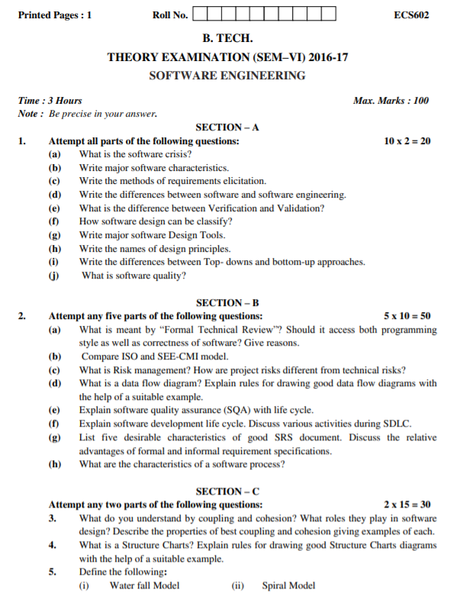
Old Question Papers

Slide 98
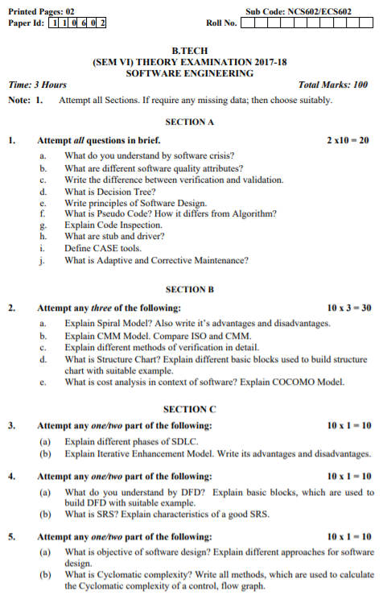
Old Question Papers

Slide 99
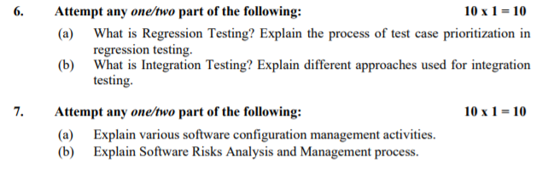
Old Question Papers

Slide 100
Expected Questions for University Exam
Explain modularity? Explain Under modularity and over modularity in a software should be avoided.
Describe data design at architectural level.
What are different techniques to estimate size of the program? Which technique is better and why?
Discuss the main advantages of using an object-oriented approach for software design.
Discuss the differences between object oriented and function oriented design

Slide 101
Summary
Software Design
Basic Concept of Software Design
Architectural Design Low Level Design: Modularization
Design Structure Charts
Pseudo Codes
Flow Charts
Coupling and Cohesion Measures
Design Strategies:
Function Oriented Design
Object Oriented Design
Top-Down and Bottom-Up Design
Software Measurement and Metrics
Various Size Oriented Measures
Halestead’s Software Science
Function Point (FP) Based Measures
Cyclomatic Complexity Measures, Control Flow Graphs

Slide 102
References
R. S. Pressman, Software Engineering: A Practitioners Approach, McGraw Hill.
Rajib Mall, Fundamentals of Software Engineering, PHI Publication.
K. K. Aggarwal and Yogesh Singh, Software Engineering, New Age International Publishers.
Pankaj Jalote, Software Engineering, Wiley
Deepak Jain,” Software Engineering: Principles and Practices”, Oxford University Press.
Munesh C. Trivedi, Software Engineering, Khanna Publishing House
N.S. Gill, Software Engineering, Khanna Publishing House

Slide 103
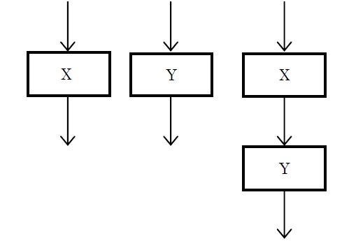
Example
The cyclomatic complexity of each of the modules X and Y shown below is 10. What is the cyclomatic complexity of the sequential integration shown on the right hand side?

Slide 104
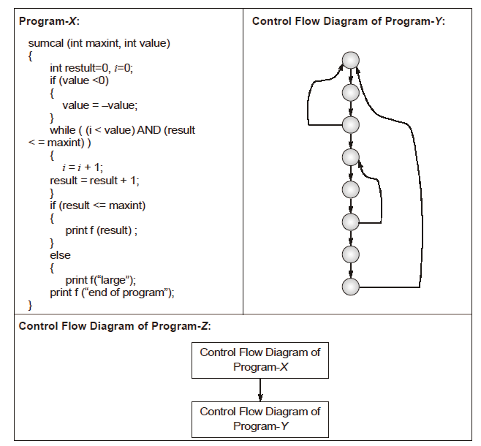
Example

Slide 105
Example
Consider a software project with the following information domain characteristic for calculation of function point metric.
Number of external inputs (I) = 30
Number of external output (O) = 60
Number of external inquiries (E) = 23
Number of files (F) = 08
Number of external interfaces (N) = 02
It is given that the complexity weighting factors for I, O, E, F and N are 4, 5, 4, 10 and 7, respectively. It is also given that, out of fourteen value adjustment factors that influence the development effort, four factors are not applicable, each of he other four factors have value 3, and each of the remaining factors have value 4. The computed value of function point metric is

